Slide 1
Week 3 – Distributed systems

Slide 2
Recap
Distributed Systems Intro
Cloud Intro
Types of Application Architecture
Distributed storage and Data processing(Big Data example)
Containers

Slide 3
Recap
Distributed system composition
Distributed System design
Load Balancer types

Slide 4
Today’s Topics
Operational Requirements
Scaling design patterns
ICA 2 - Kubernetes

Slide 5
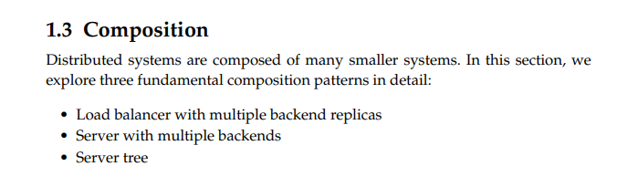
Composition

Slide 6
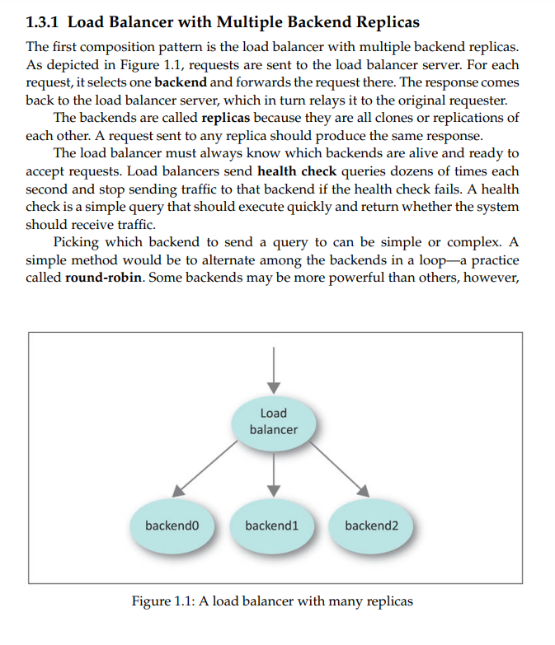

Slide 7
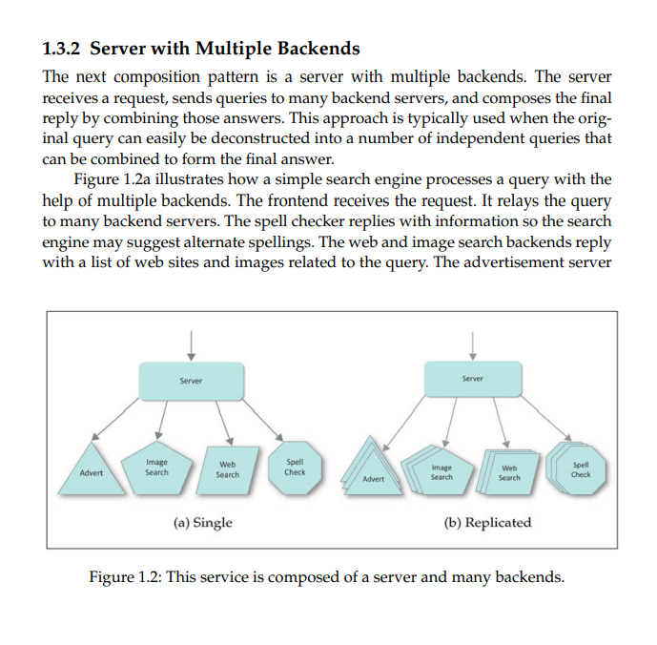

Slide 8
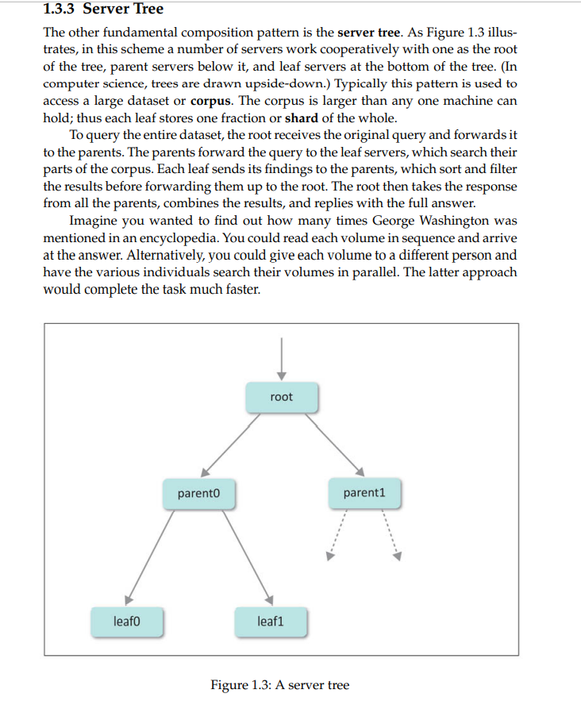

Slide 9
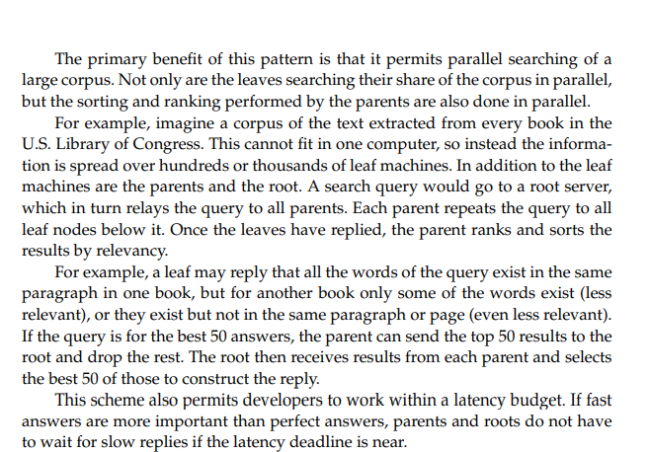
Server Tree

Slide 10
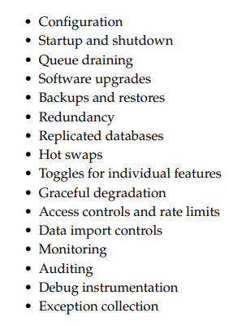
Operational Requirements

Slide 11
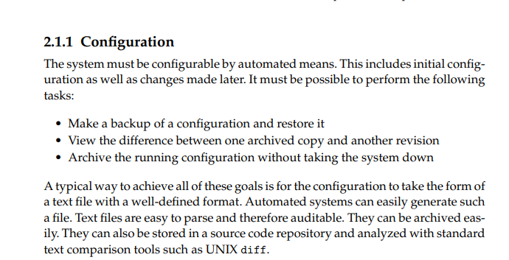
Operational Requirements

Slide 12
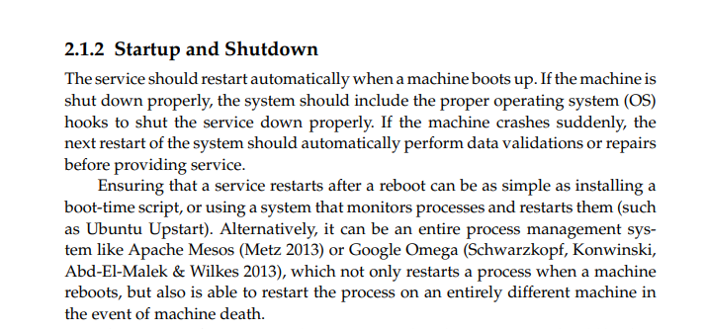
Operational Requirements

Slide 13
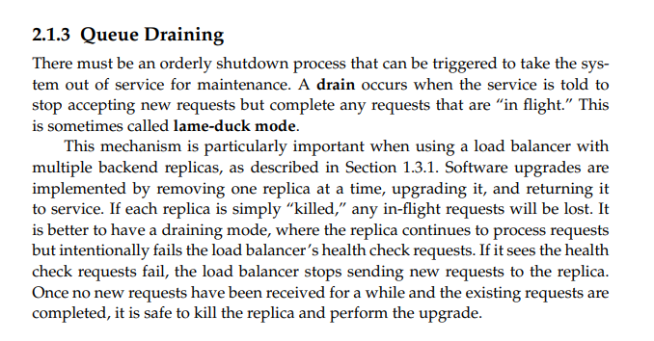
Operational Requirements

Slide 14
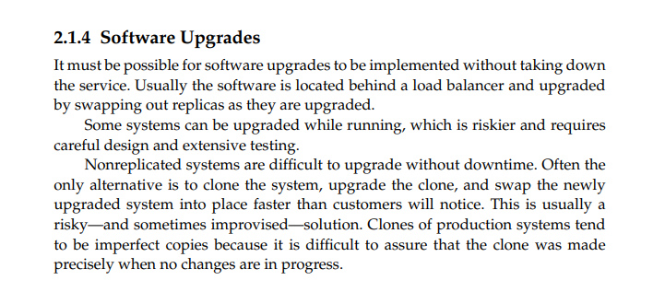
Operational Requirements

Slide 15
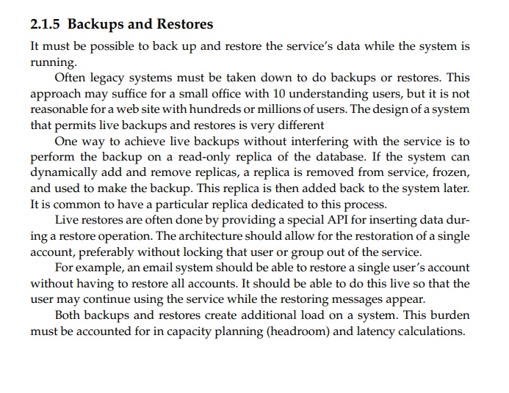
Operational Requirements

Slide 16
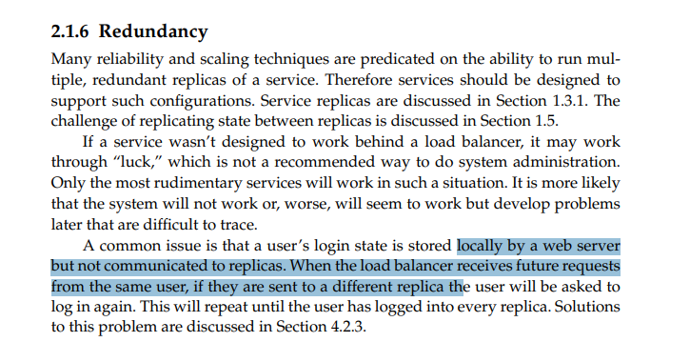
Operational Requirements

Slide 17
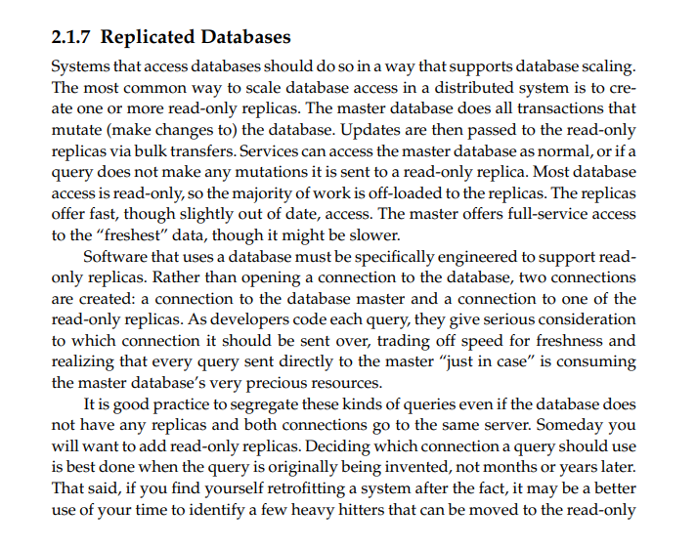
Operational Requirements

Slide 18
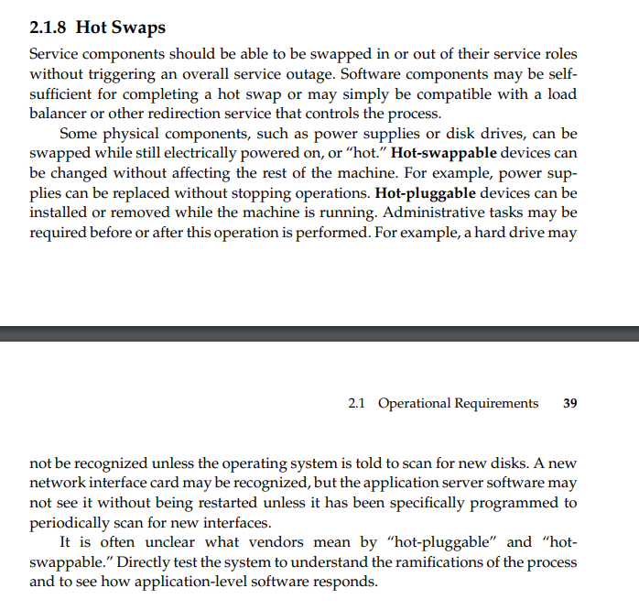
Hot Swaps

Slide 19
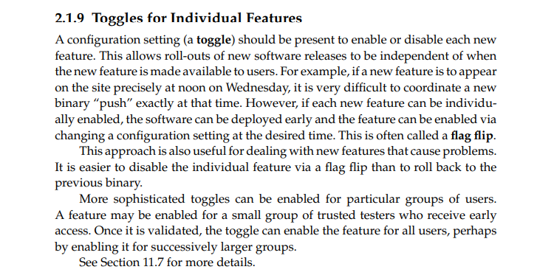
Operational Requirements

Slide 20
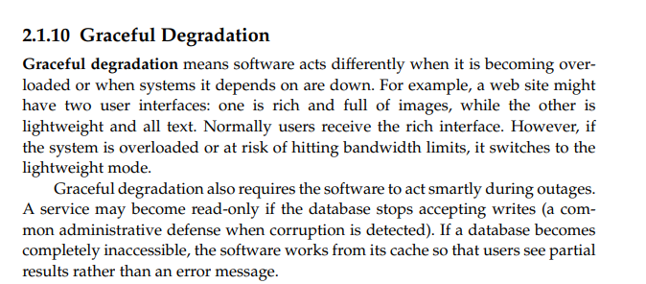
Operation Requirements

Slide 21
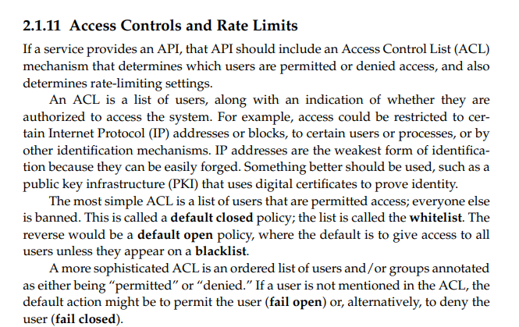
Operation Requirements

Slide 22
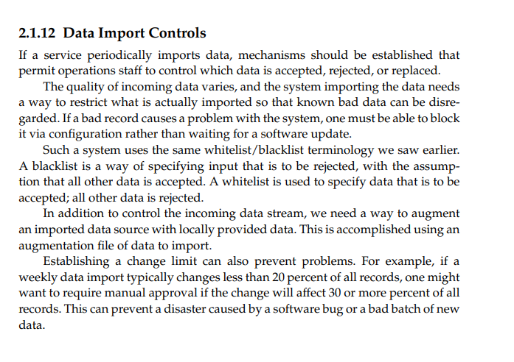
Operational Requirements

Slide 23
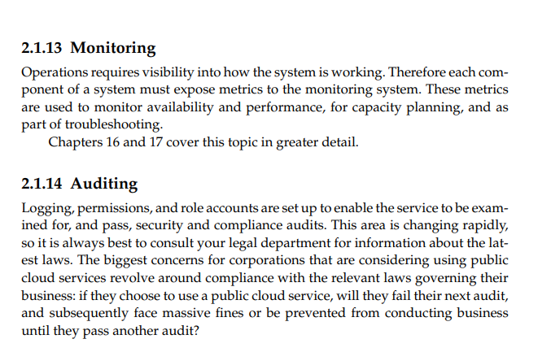
Operational Requirements

Slide 24
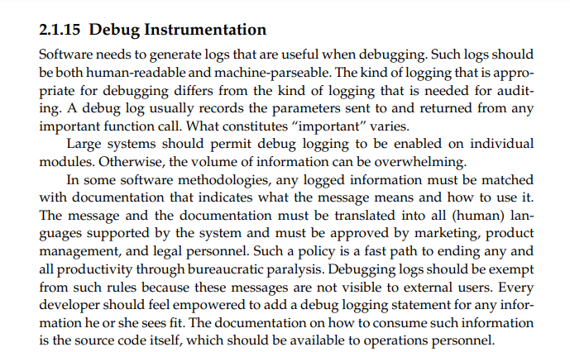
Operational Requirements

Slide 25
Application Architectures
Recap from previous class(Monolithic, Microservices, cloud based)
Single machine web server
Three Tier Web service
Four Tier Web service
Reverse Proxy service
Cloud-Scale service
Message bus Architecture
Service Oriented Architecture

Slide 26
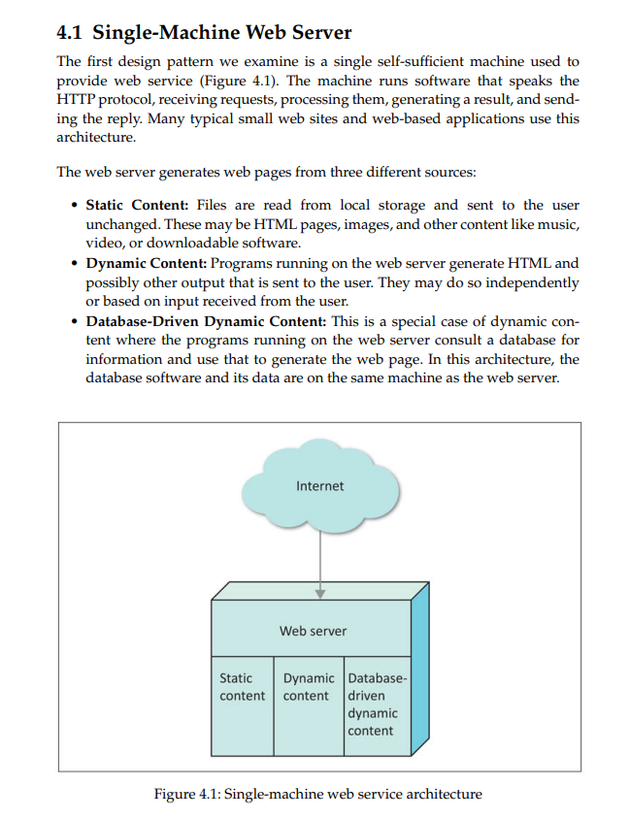

Slide 27
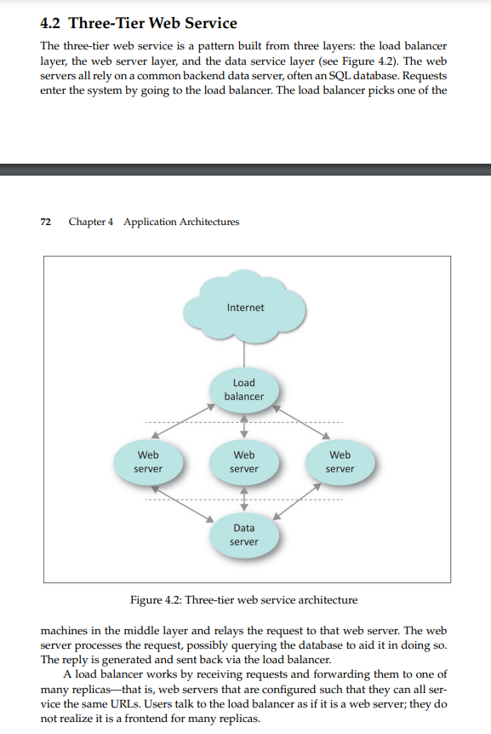

Slide 28
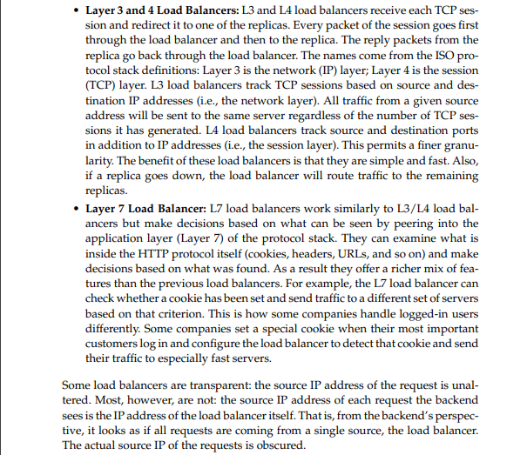
Load Balancer Types

Slide 29
Load Balancing types
1. DNS Round Robin: This works by listing the IP addresses of all replicas in the DNS entry for the name of the web server. Web browsers will receive all the IP addresses but will randomly pick one of them to try first. Thus, when a multitude of web browsers visit the site, the load will be distributed almost evenly among the replicas. The benefit to this technique is that it is easy to implement and free.
There is no actual hardware involved other than the DNS server, which already exists. However, this technique is rarely used because it doesn’t work very well and is difficult to control. It is not very responsive. If one replica dies unexpectedly, clients will continue to try to access it as they cache DNS heavily. The site will appear to be down until those DNS caches expire. There is very little control over which servers receive which requests. There is no simple way to reduce the traffic sent to one particular replica if it is becoming unusually overloaded.

Slide 30
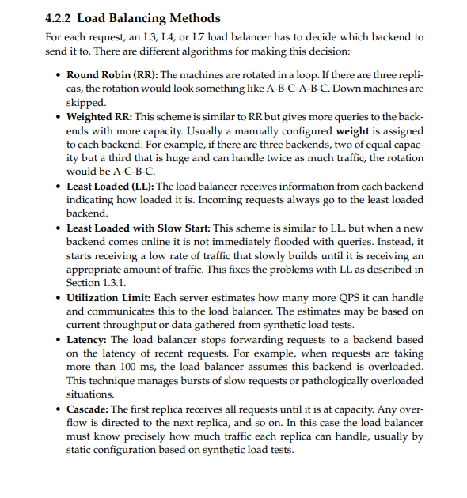

Slide 31
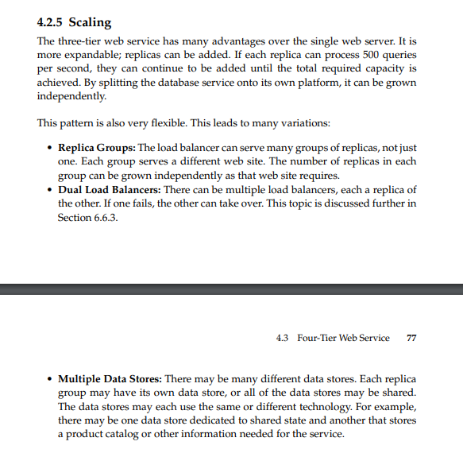

Slide 32
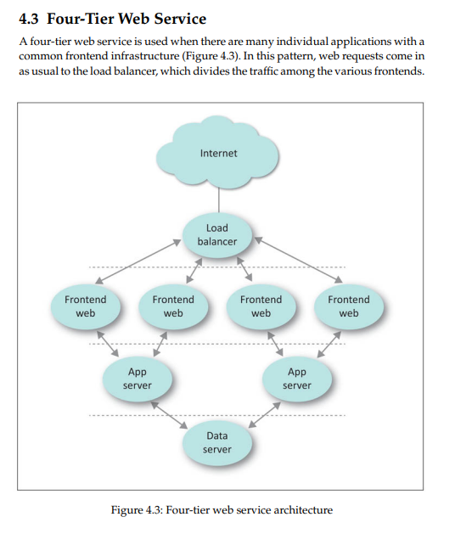

Slide 33
Four-tier Web service
The frontends handle interactions with the users, and communicate to the application servers for content. The application servers access shared data sources in the final layer. The difference between the three-tier and four-tier designs is that the application and the web servers run on different machines.
The benefits of using the latter design pattern are that we decouple the customer-facing interaction, protocols, and security issues from the applications. The downside is that it takes a certain amount of trust for application service teams to rely on a centralized frontend platform team. It also takes management discipline to not allow exceptions

Slide 34
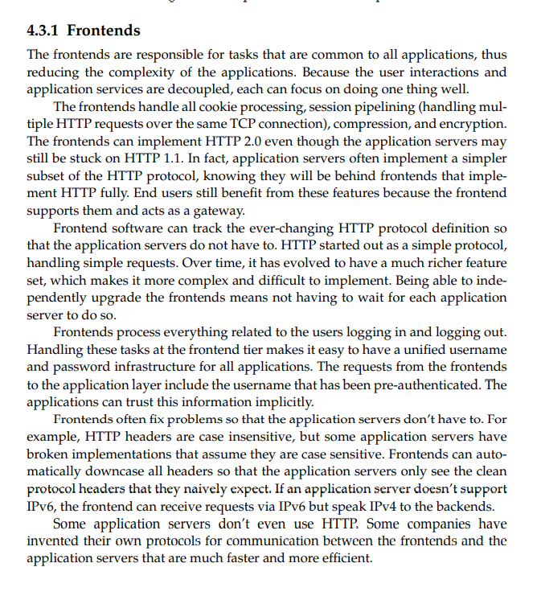

Slide 35
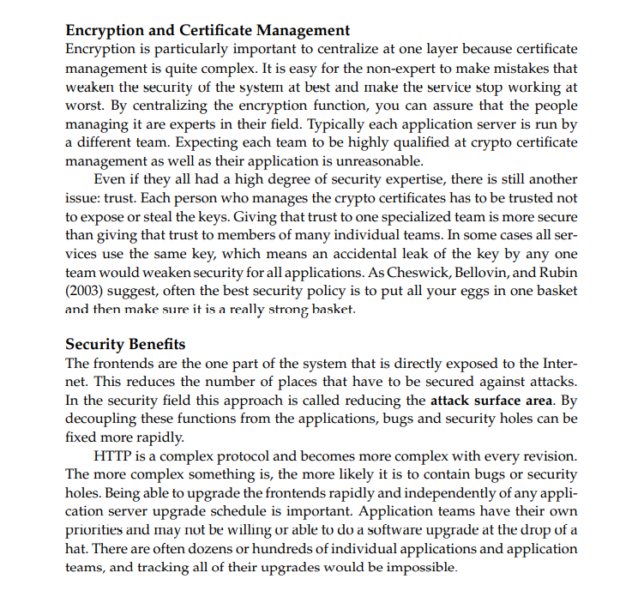

Slide 36
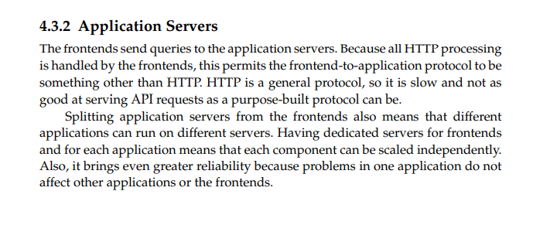

Slide 37
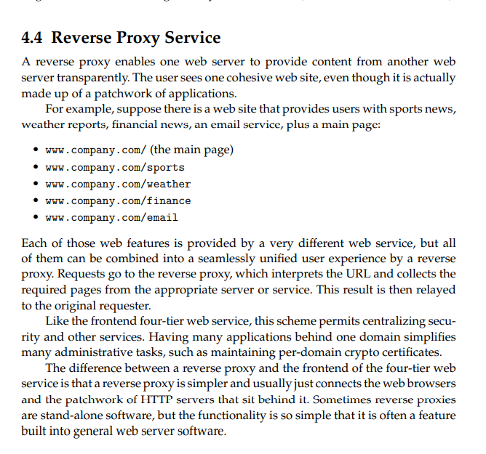

Slide 38
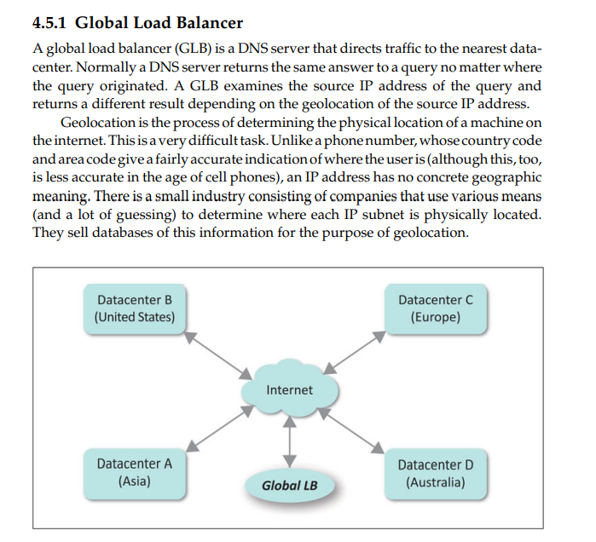
Cloud-Scale Service
Cloud-scale services are globally distributed. The service infrastructure uses one of the previously discussed architectures, such as the four-tier web service, which is then replicated in many places around the world. A global load balancer is used to direct traffic to the nearest location

Slide 39
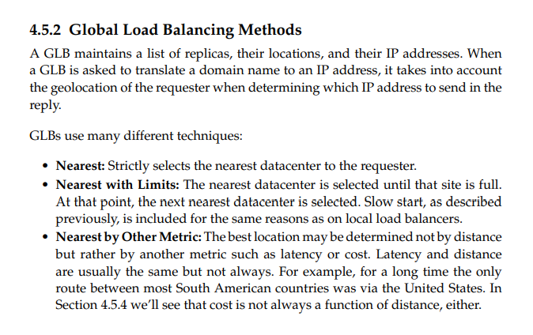

Slide 40
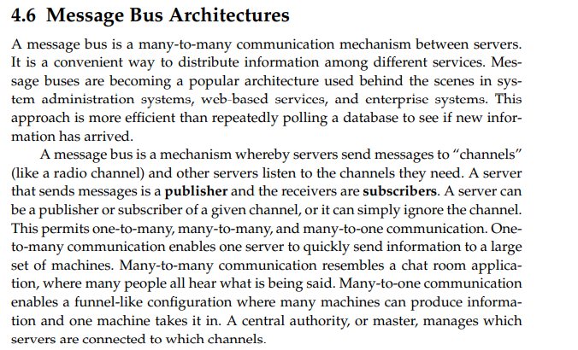

Slide 41
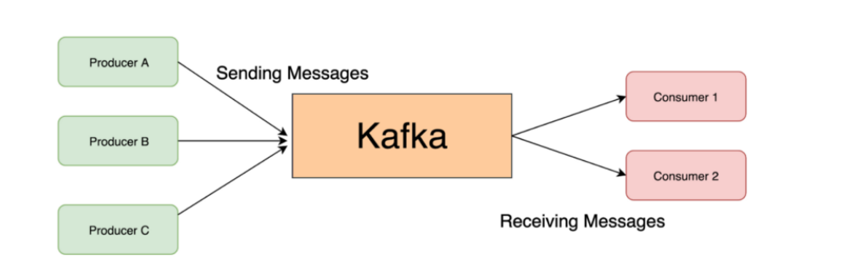
Apache Kafka

Slide 42
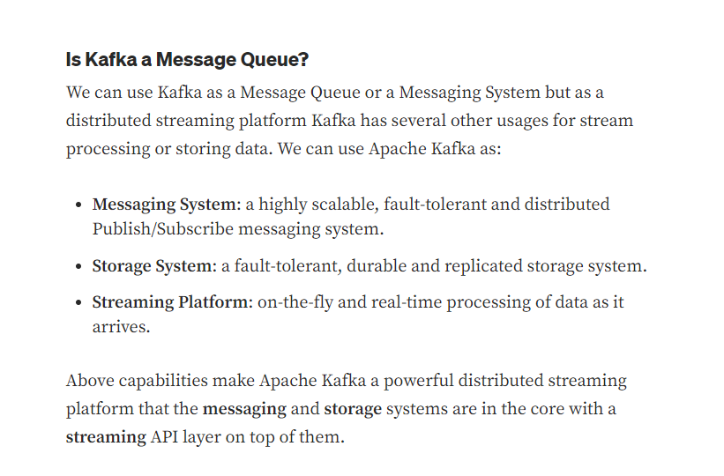

Slide 43
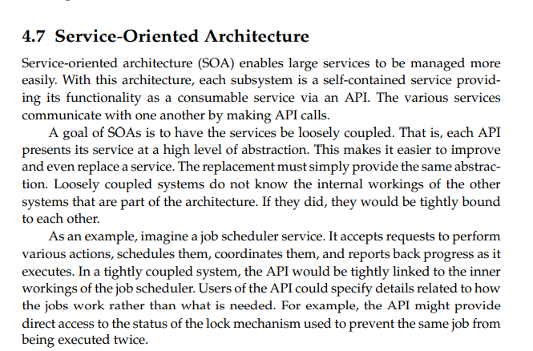

Slide 44
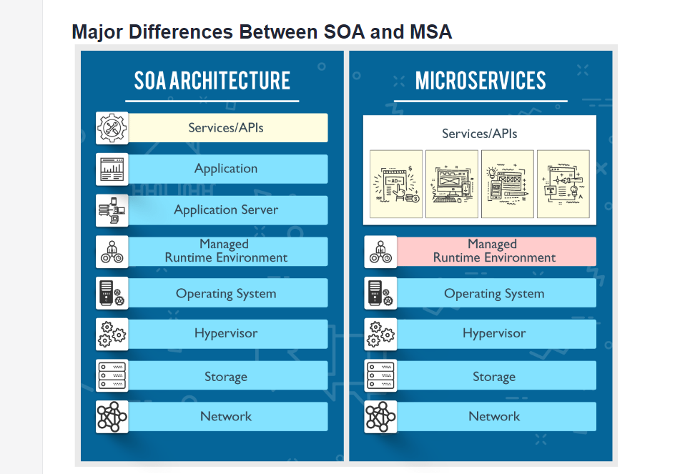

Slide 45
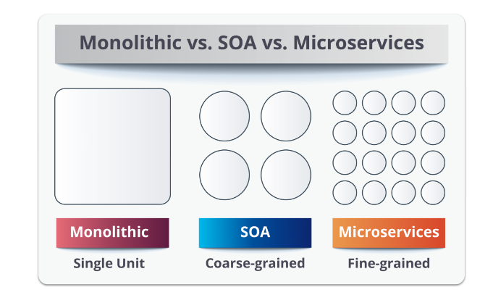

Slide 46
Design patterns for scaling
Scaling up
AKF Scaling cube
Caching
Data Sharding
Threading
Queuing
Content Delivery Networks

Slide 47
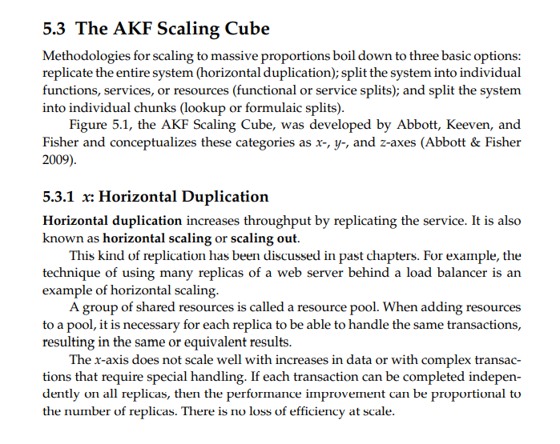

Slide 48
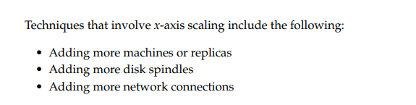
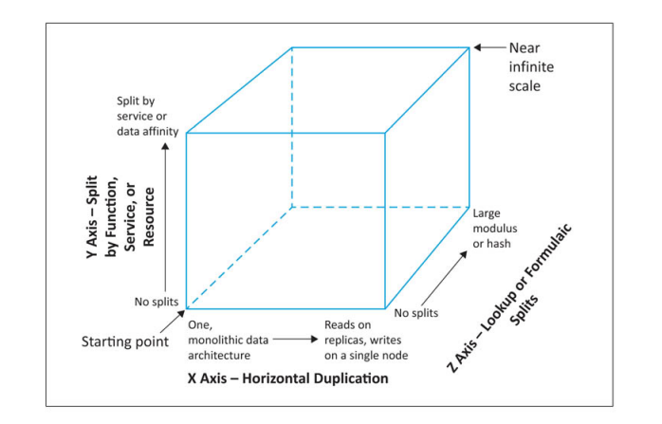

Slide 49
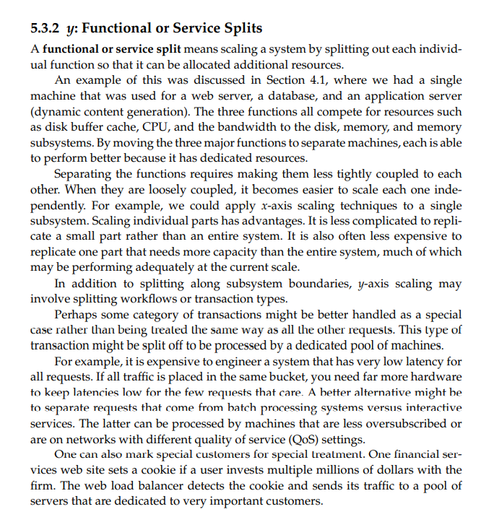

Slide 50
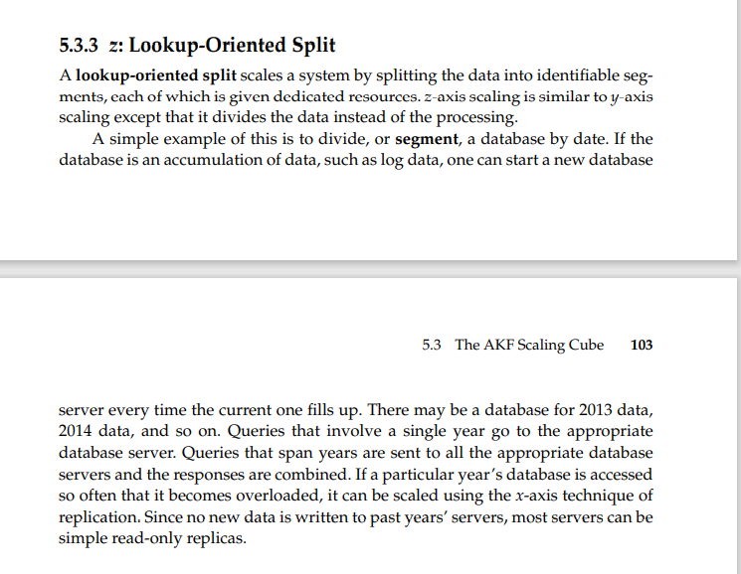

Slide 51
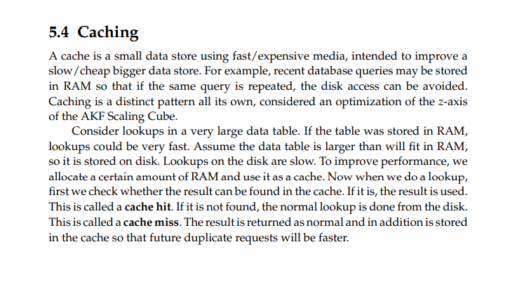

Slide 52
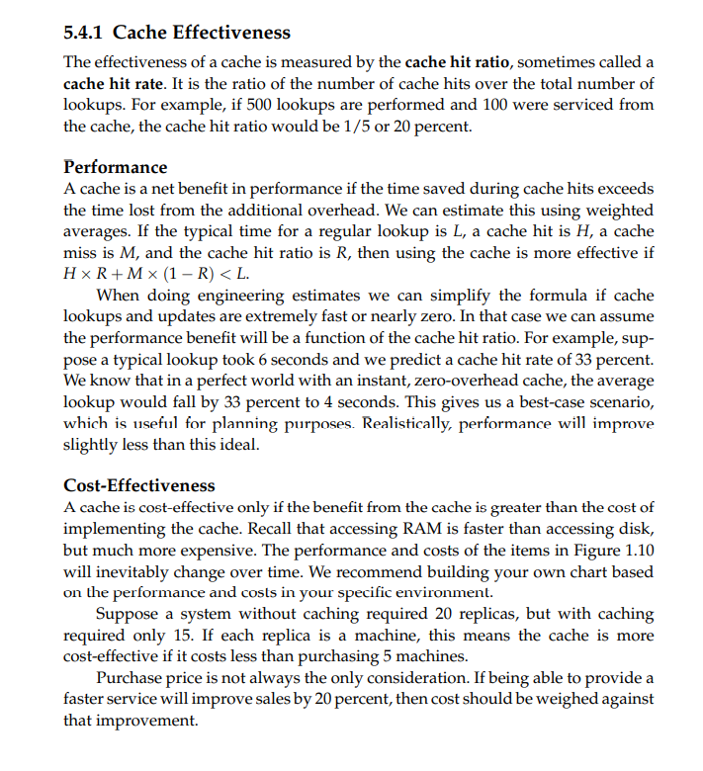

Slide 53
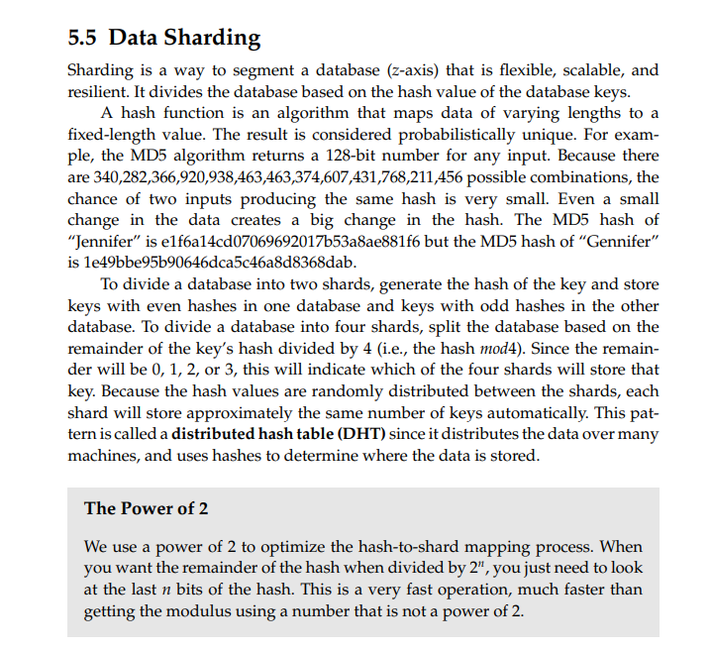

Slide 54
Different Types of Sharding
Ranged/dynamic sharding(using look up table)
Algorithmic/hashed sharding
Entity-/relationship-based sharding
Geography-based sharding

Slide 55
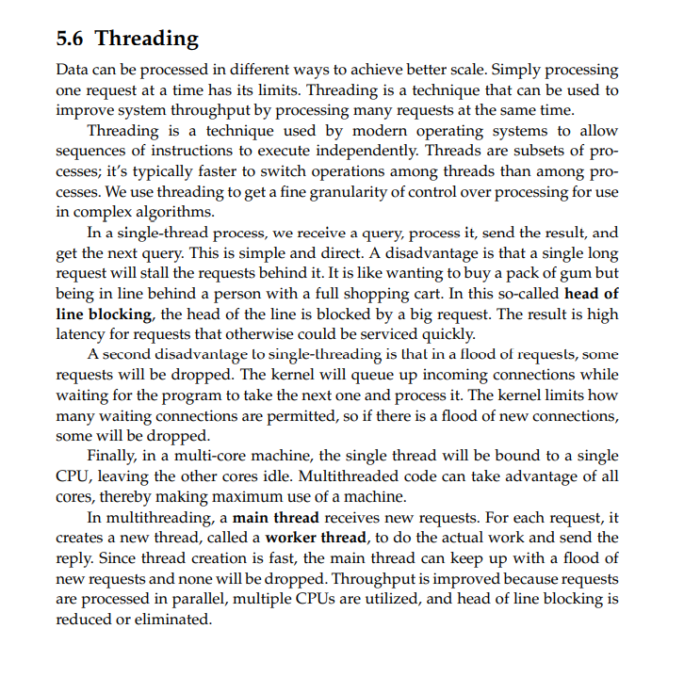

Slide 56
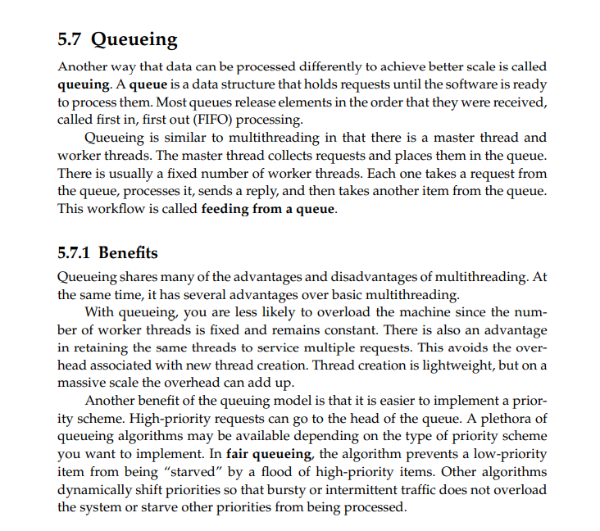

Slide 57
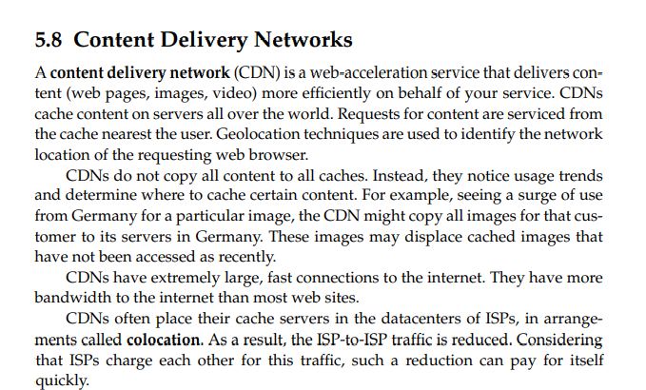

Slide 58
Examples of Content Delivery Networks
Google Cloud CDN
Azure Front Door
AWS Cloud front

Slide 59
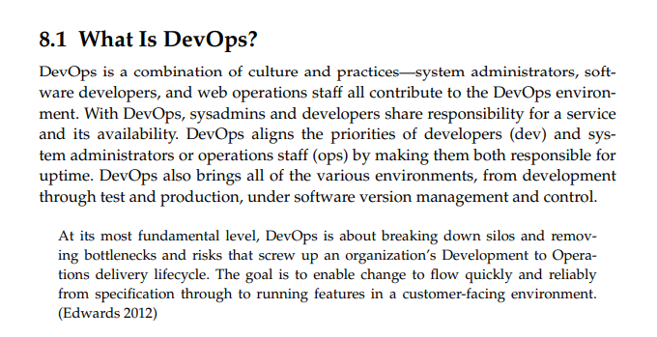

Slide 60

Traditional Methodology

Slide 61

Devops is more AGILE

Slide 62


Slide 63


Slide 64


Slide 66
Devops – Values and principles
Relationships
Integration
Automation
Continuous improvement

